Slide 1
THE CONGRESSIONAL AWARD ADVISOR’S GUIDE

Slide 2
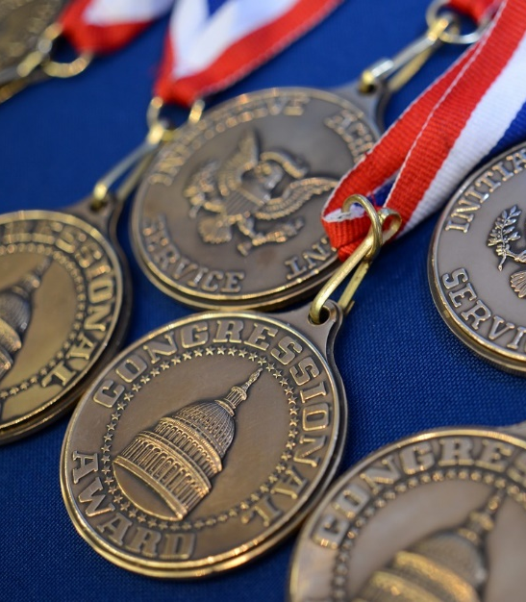
ABOUT
U.S. Congress’ award for youth
Highest honor bestowed upon a youth civilian through the U.S. Senate and House of Representatives
Open to youth ages 13 ½ - 23
Encourages goal-setting and fosters principles of citizenship

Slide 3
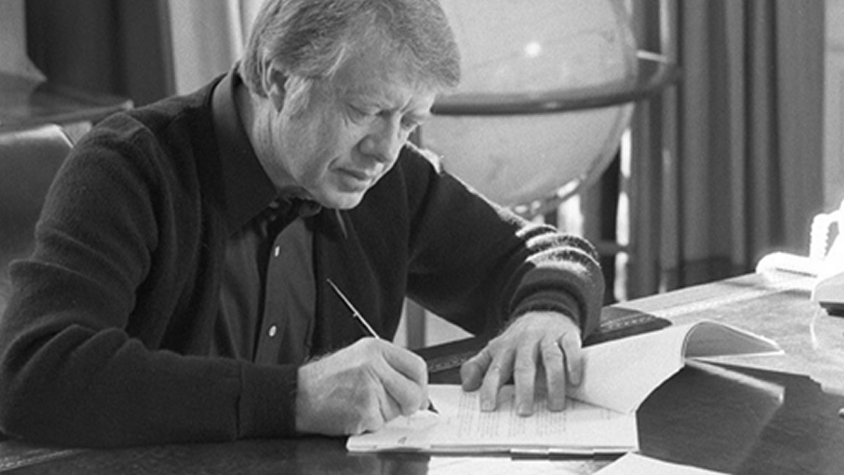
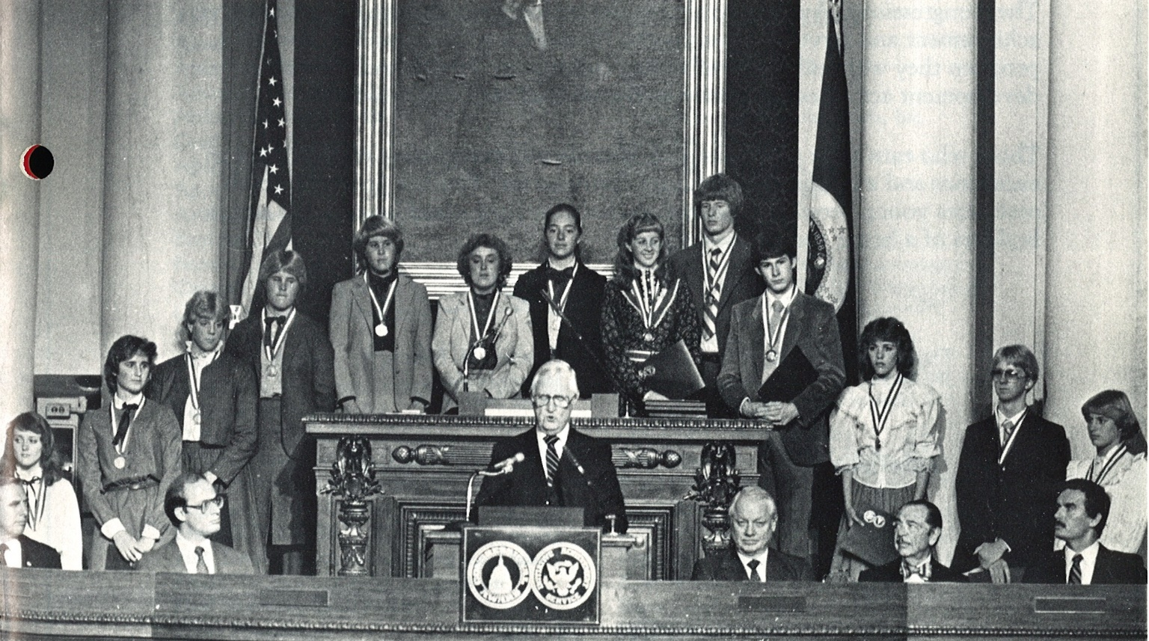
HISTORY
Founded by Congress in 1979
Public Law 96-114:
The Congressional Award Act
Public-private partnership
Non-partisan program to honor initiative, service, and achievement in America’s youth

Slide 4
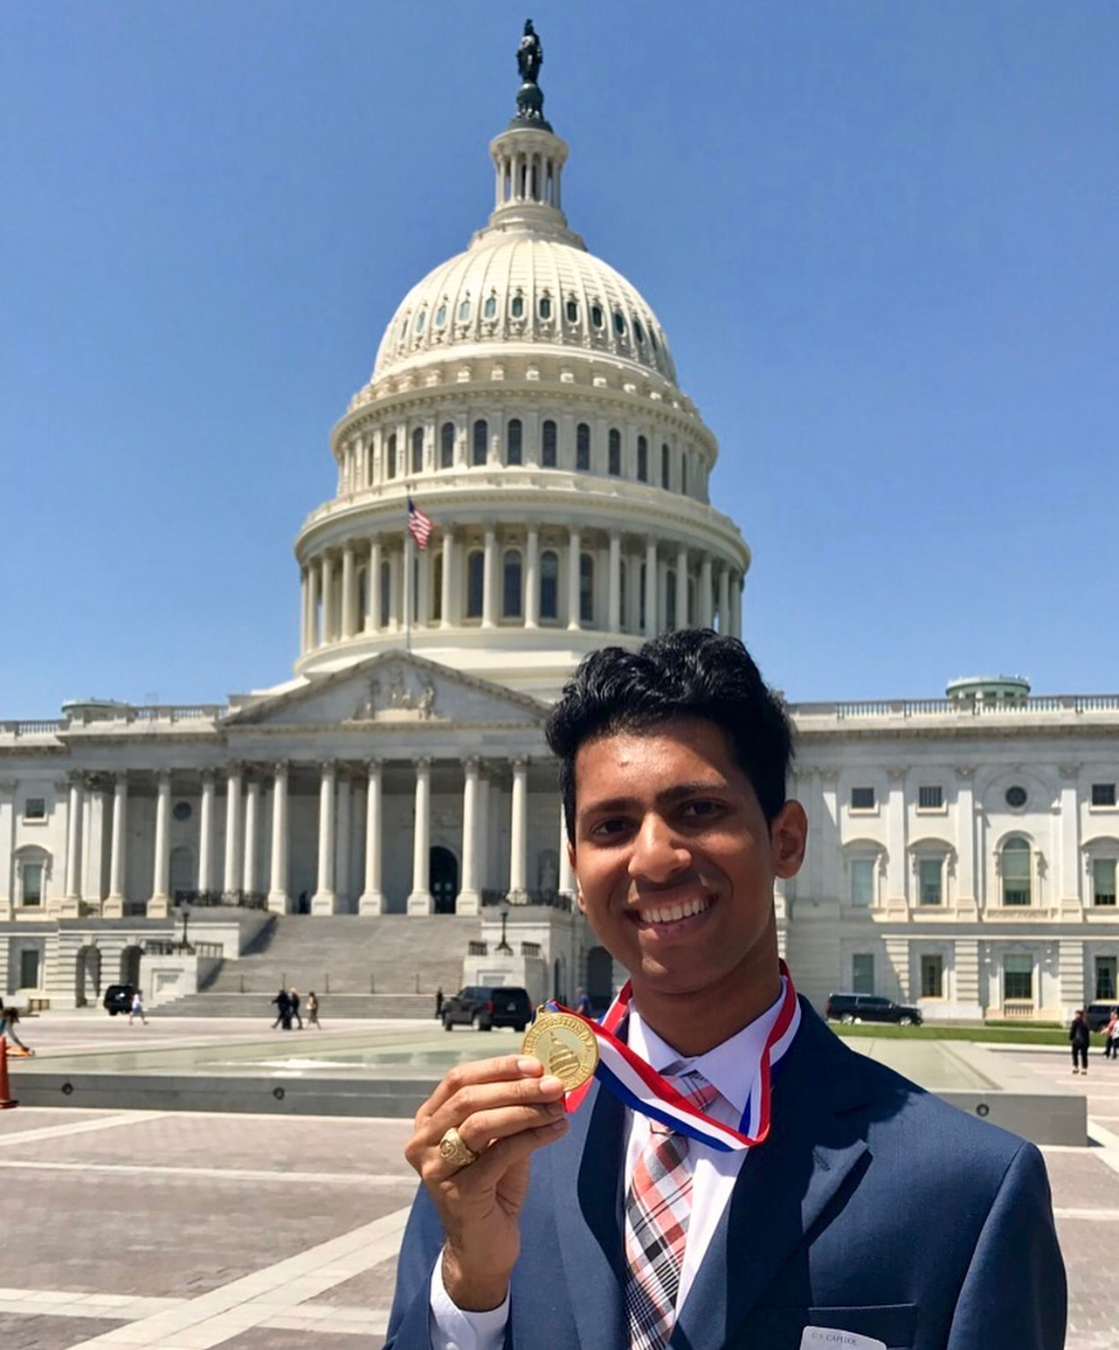
BENEFITS
Superlative for college, job,
scholarship, internship applications
Mentor-based opportunities
Serves communities near and far
Interactions with Members of Congress
Medals struck by U.S. Mint

Slide 5
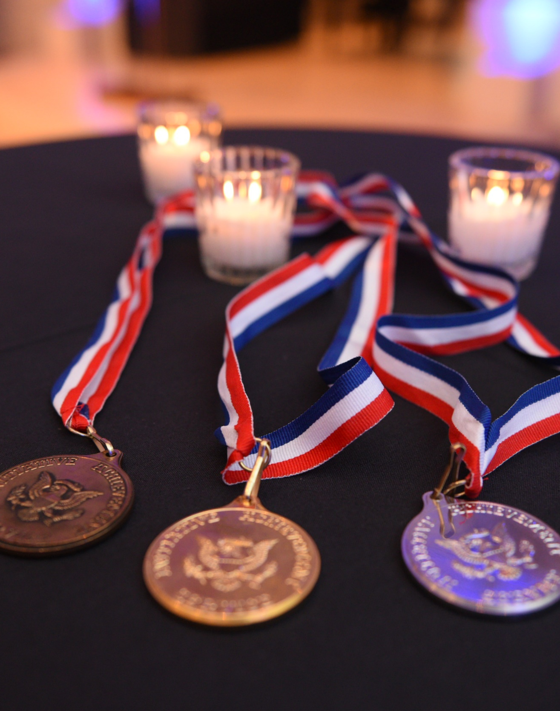
AWARD LEVELS
The program is cumulative.
Participants may start at the lowest level and progress level-by-level or advance directly to a higher level.
Bronze Certificate
Silver Certificate
Gold Certificate
Bronze Medal
Silver Medal
Gold Medal

Slide 6
PROGRAM REQUIREMENTS
Minimum hour and month totals
 | BRONZE CERTIFICATE | SILVER CERTIFICATE | GOLD CERTIFICATE | BRONZE MEDAL | SILVER MEDAL | GOLD MEDAL
VOUNTARY PUBLIC SERVICE | 30 Hours | 60 Hours | 90 Hours | 100 Hours | 200 Hours | 400 Hours
VOUNTARY PUBLIC SERVICE | No min. month requirement | No min. month requirement | 6 Months | 7 Months | 12 Months | 24 Months
PERSONAL DEVELOPMENT | 15 Hours | 30 Hours | 45 Hours | 50 Hours | 100 Hours | 200 Hours
PERSONAL DEVELOPMENT | No min. month requirement | No min. month requirement | 6 Months | 7 Months | 12 Months | 24 Months
PHYSICAL FITNESS | 15 Hours | 30 Hours | 45 Hours | 50 Hours | 100 Hours | 200 Hours
PHYSCIAL FITNESS | No min. month requirement | No min. month requirement | 6 Months | 7 Months | 12 Months | 24 Months
EXPEDITION OR EXPLORATION | 1 Day | 2 Days | 3 Days | 2 Day, 1 Night Trip | 3 Day, 2 Night Trip | 5 Day, 4 Night Trip

Slide 7
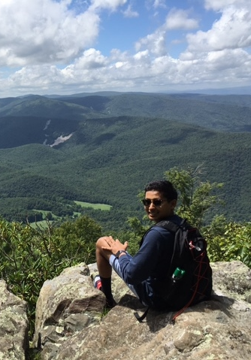
THE PROGRAM
Voluntary
Public Service
Personal Development
Physical Fitness
Expedition/Exploration

Slide 8
VOLUNTARY
PUBLIC SERVICE
Serving without compensation
Identifying a need in your community and finding a way to volunteer directly
Activities must benefit greater community at-large (public organizations, non-partisan, non-religious, no hot-button issues)
Set up to four different goals
Sharing time and talents for the benefit of others

Slide 9
VOLUNTARY PUBLIC SERVICE DO'S AND DON’TS
Activities coordinated or completed under the direction of a religious institution must provide service to the greater community-at-large and the activities cannot include any religious instruction or proselytizing. These activities may be counted towards Personal Development.
Activities in which you receive compensation or fulfill graduation requirements are not be allowed, this includes paid internships.
Volunteering at a private business or entity does not qualify for Voluntary Public Service. You may not volunteer to work at a private office, such as a law firm, doctor’s office, sports camps, or private dance studios as these activities do not benefit the public. However, these activities may be counted towards Personal Development.
Activities completed through an organization that charges a fee for participants may only be used towards Voluntary Public Service if the organization offers financial aid/scholarships for participants who may not be able to afford the fees.
Sharing time and talents for the benefit of others

Slide 10
VOLUNTARY PUBLIC SERVICE DO'S AND DON’TS
Voluntary Public Service activities must be non-partisan. You may not work for an elected official, promote a political issue or volunteer on a political campaign for Voluntary Public Service. This includes volunteering for entities with a partisan or issue-based focus.
You may only record hours in which you are actively pursuing your goal.
Participants who are establishing their own non-profit organization should contact the National Office to discuss their goals and activities and special consideration for the number of indirect hours that they complete.
Sharing time and talents for the benefit of others

Slide 11
VOLUNTARY PUBLIC SERVICE COVID ACCOMODATION
Indirect service activities include planning, training, and fundraising and can only make up 25% of your total Voluntary Public Service hours. The other 75% must be direct hours, where you are interacting with and provided a direct service to the community you are serving.
The Congressional Award will lift the restrictions of direct vs. indirect service requirements for the rest of 2021, enabling participants to complete Voluntary Public Service activities from the safety of their homes.
Sharing time and talents for the benefit of others

Slide 12
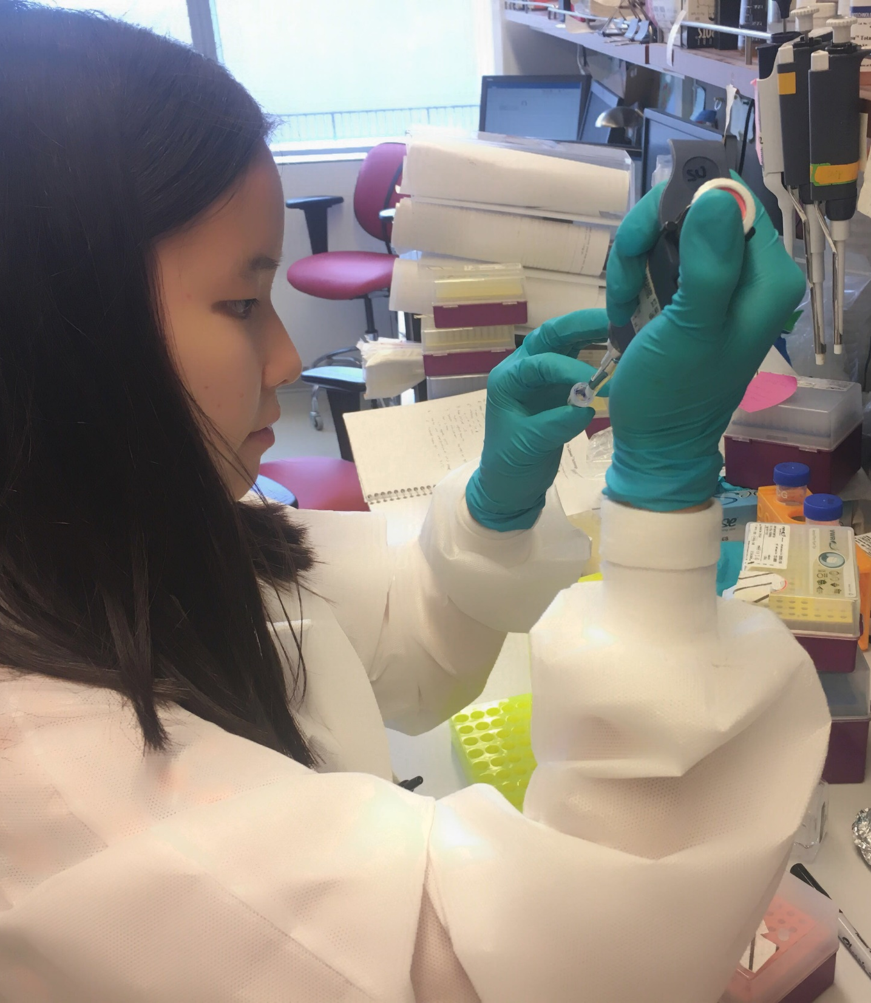
PERSONAL DEVELOPMENT
Pursue a new activity or
advance ability an existing interest
Goals must be specific and measurable
Count part-time work if you’re a full-time student. Count educational activities if you’re employed full-time.
Set up to two different goals
Developing skills in a personal,
career, or social interest

Slide 13
PERSONAL DEVELOPMENT DO'S AND DON'TS
If you are a full-time student, taking on a part-time job may be counted towards Personal Development.
You may not count any activities that you receive class credit for. Improving your skills in a subject or studying for a standardized test may be used for Personal Development however, your activities must occur outside of school and not be a requirement or assignment for any class.

Slide 14
PHYSICAL
FITNESS
Goals cannot be competitive
Goals must be specific and measurable
Include current fitness level and determine where you’d like to advance
Fitness activities do not have to be strenuous in order to be challenging
Set up to two different goals
Improving one’s quality of life

Slide 15
PHYSICAL FITNESS DO'S AND DON’TS
School sports and team practices are acceptable activities if they are completed outside of class time.
Gym class or PE does not count for Physical Fitness.
Goals should be personally challenging and focused on your individual well-being. A goal of becoming team captain is not an acceptable goal as your success depends on the decisions of others.
Using activity trackers, such as Fitbits, may be useful in tracking your activities however; activities that are part of your daily routine (i.e., walking to class) cannot be counted towards your Physical Fitness goal. Your activities need to take place outside of your daily routine.
Improving one’s quality of life

Slide 16
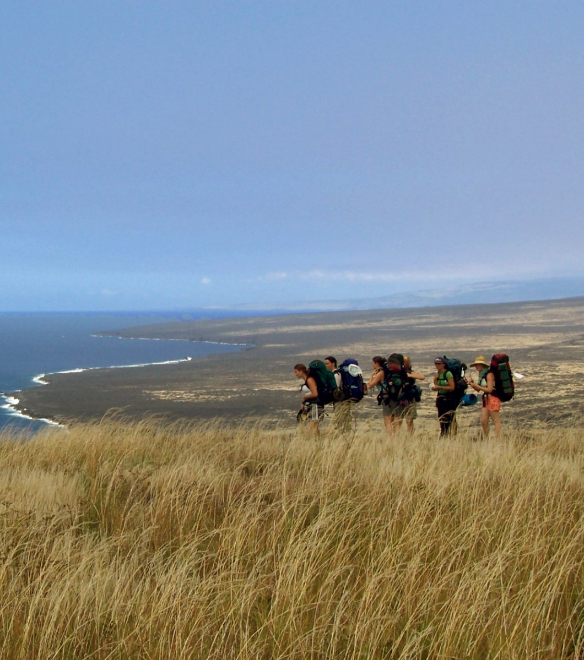
EXPEDITION or
EXPLORATION
Expedition: Discover the great outdoors
Exploration: Experience culture, history, humanity
Develop a spirit of adventure
Organize, prepare, and execute
Does not have to be costly or far off
Immersion in an unfamiliar
environment or culture

Slide 17
EXPEDITION OR EXPLORATION DO'S AND DON'TS
An Expedition/Exploration should be a new, unique experience. It should require a level of challenge that enables you to step outside of your daily routine, leave your comfort zone, and immerse yourself in a new culture or environment.
You must complete 6-8 hours of immersion activities per day for that day to count towards the day requirement.
Must be a trip that you plan and lead. Mission trips, conferences, cruises, competitions, workshops, and sign-up and go trips may not be used for the Expedition/Exploration.
Your Expedition/Exploration should not consist of activities to pursue your next stage in life. This includes visiting/touring prospective colleges or participating in an internship or work-study program.
Immersion in an unfamiliar
environment or culture

Slide 18
EXPEDITION OR EXPLORATION DO'S AND DON'TS
If you choose to complete a trip that meets the overnight and/or day requirements for a higher level of the award than what you are applying for, you may submit it with a lower-level Record Book. If you would like to re-submit your Expedition/Exploration with a higher-level Record Book you may do so, keeping in mind that the National Office will not necessarily approve a trip at a higher level, even if it was approved for a lower level.
Medal levels of the Award require that the days and nights be consecutive. You cannot combine trips to meet the requirements of the Bronze, Silver or Gold Medal.
You only need to submit one Expedition/Exploration with each Record Book submission. For example, if your first Record Book submission is for the Silver Medal, you only need to submit a two consecutive overnight trip. You do not need to submit a one-day trip for the Bronze Certificate, a two-day trip for the Silver Certificate, etc.
Please ensure that you submit a thorough write-up of your trip. The Record Book includes a list of questions to help guide you in your write-up. Your submission should not consist of brief bullet points.
Immersion in an unfamiliar
environment or culture

Slide 19
VIRTUAL EXPEDITION/EXPLORATION COVID ACCOMODATION
Due to travel restrictions and safety concerns associated with the COVID-19 pandemic, all participants will be able to submit Virtual Expeditions/Explorations with modified guidelines through December 31, 2021.
Each participant will be required to choose a country/location and pick activities (taste of the world, interview a local, landmark review, virtual museum tour, etc.) to explore the history, culture, and customs of the location they have chosen. If multiple countries or locations are chosen, participants will have to compare and contrast the locations through their activities and research.
Submission Requirements
Bronze Certificate: 1 activity with a 1-page write-up Silver Certificate: 2 activities with a 2-page write-up Gold Certificate: 3 activities with a 3-page write-up Bronze Medal: 4 activities with a 5-6-page write-up Silver Medal: 5 activities with a 7-8-page write-up Gold Medal: 6 activities with a 9-10-page write-up
Immersion in an unfamiliar
environment or culture

Slide 20
DEADLINES & CRITERIA
GOLD MEADALIST DEADLINE | REVISION DEADLINES
FEBRURARY 1ST, ANNUALLY | MARCH 15TH, ANNUALLY
Notes:
- The Revision Deadline for this year, 2020, was extended to 3/29/2021

Slide 21
VIRTUAL EXEMPTIONS
SUBMISSION REQUIREMENTS
Award level | # of activities | Page write-up
Bronze Certificate | 1 | 1 page
Silver Certificate | 2 | 2 pages
Gold Certificate | 3 | 3 pages
Bronze Medal | 4 | 5-6 pages
Silver Medal | 5 | 7-8 pages
Gold Medal | 6 | 9-10 pages
Virtual Expedition/Exploration
Participants can submit Virtual Expeditions/Explorations through December 31st, 2021
Each participant must complete both their activity and write-up
More information can be found on our website
Notes:
Site can be reached at: https://www.congressionalaward.org/virtual-expeditions-explorations/

Slide 22
VIRTUAL EXEMPTIONS
Indirect Service
Activities such as planning, training, and fundraising could only make up 25% of total Voluntary Public Service hours
This rule has been waived until December 31st 2021
Notes:
Typically, the policy on Indirect service reads as this:
- Indirect service activities include planning, training, and fundraising and can only make up 25% of your total Voluntary Public Service hours. The other 75% must be direct hours, where you are interacting with and providing a direct service to the community you are serving.
This rule was changed because due to the nature of the Pandemic(tm)

Slide 23
VIRTUAL PRESENTATIONS
Virtual Presentations
Virtual Presentations are scheduled quarterly by CAF staff. Participants have the opportunity to 'opt-in' for a virtual recognition ceremony with their Member of Congress after they have earned their Bronze or Silver Medal
Participants can also be honored in Virtual Statewide Ceremonies
In "normal times" these presentations would be done in person
Notes:
Typically, the policy on Indirect service reads as this:
- Indirect service activities include planning, training, and fundraising and can only make up 25% of your total Voluntary Public Service hours. The other 75% must be direct hours, where you are interacting with and providing a direct service to the community you are serving.
This rule was changed because due to the nature of the Pandemic(tm)

Slide 24
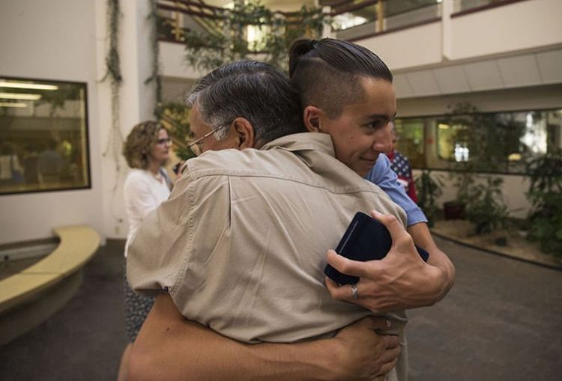
ADVISOR & VALIDATOR GUIDE
As an Advisor or Validator, you play an important role!
Advisors guide participants through the goal-setting process in each of the four program areas and monitor their progress toward the Congressional Award.
Validators assist the participant with individual activities.

Slide 25
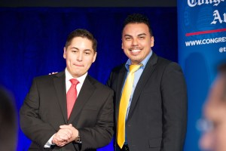
YOUR ROLE AS THE ADVISOR:
Link to full Advisor/Validator Guide here.
Review the Congressional Award requirements and guidelines as provided in the program booklet
Assist the participant in setting goals
Identify appropriate activities and qualified Validators
Maintain periodic contact with the participant
Help the participant revise and set new goals and find activities to achieve them
Encourage the participant to obtain written comments and signatures from their validators
Once the participant has completed their Record Book, review their records and help check the complete the Record Book. Please be sure to provide comments.
Make certain that you and the participant keep a copy of the Record Book
Once the participant has submitted their Record Book, work with them to set new goals and begin working on the next level of the Award!

Slide 26
ADVISOR CHECKLIST:
Link to full document here.
Has the young person presented his or her goals and activities well? Encourage the young person to keep neat records and clearly describe goals and activities.
Are the participant’s goals SMART (Specific, Measurable, Attainable, Realistic, Timely)? Goals that are too broad, such as “I will help serve my community” or “I will get into shape” are not acceptable. Please be sure that goals clearly state a specific objective and are challenging as well as measurable.
Has the participant spread out his/her hours of Voluntary Public Service, Personal Development, & Physical Fitness? Earning a Congressional Award is a marathon not a sprint; the Congressional Award honors young people who develop lifestyles of service and personal challenge. Participants should make a commitment to their activities over a significant period of time, not simply complete the required hours quickly.
Does the participant meet the minimum months of activity required for each program area?
Assure that the participant listed only the hours and dates that he or she worked on at the current level. The National Office will keep track of cumulative hours and dates as the participant advances through the program.
Is the participant counting the same hours of activity in multiple program areas?
Within one program area, are months of activity only counted once?
Has the participant provided you with documentation of the completed activities?

Slide 27
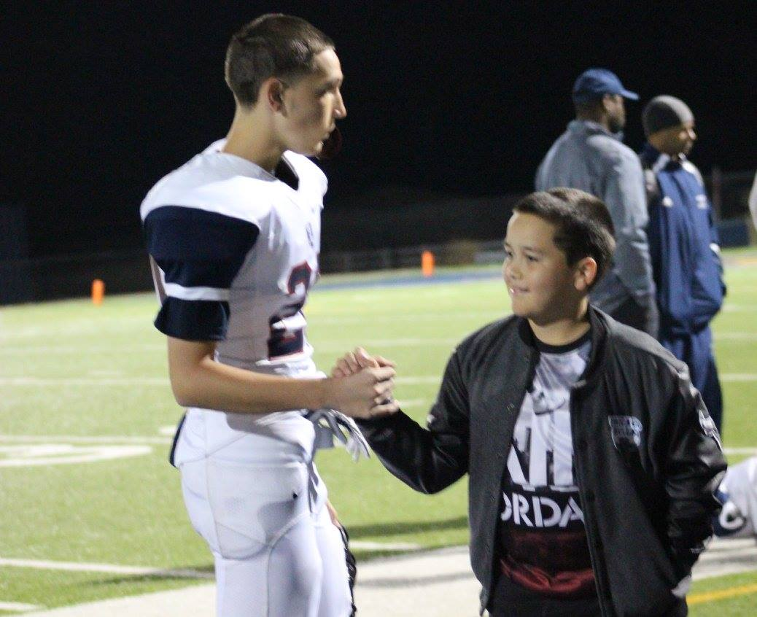
THE ROLE OF THE VALIDATOR:
Review the Congressional Award requirements and guidelines
Discuss the specific requirements for the program area in which you’ll be working with the participant
Help the participant identify their starting level
Make certain that the participant’s goal is personally challenging, achievable, worthwhile, measurable, and fulfilling
Review all of the appropriate documentation and sign their area of the Record Book
Please be sure to provide comments

Slide 28
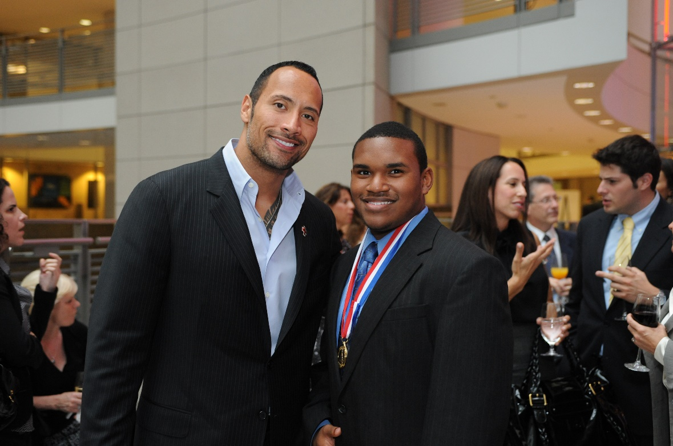
WHO IS ELIGIBLE?
Other than parents, relatives, and peers, any adult may serve as an Advisor or Validator.
Ex. Teachers, coaches, neighbors, club sponsors, and civic leaders
Congressional Award Gold Medal earners, regardless of their age.
It is the responsibility of the participants to identify their Advisor and Validators.
The appropriate Validator depends on the participant’s activities.
Validators should be knowledgeable in the activities a participant pursues to achieve a particular goal.
Ex. A young person’s goal and activities involved basketball; a coach would make a suitable validator.
Ex. A young person volunteered at an animal shelter, an employee or the volunteer coordinator would be appropriate
Yes, even Dwayne ‘The Rock’ Johnson is eligible!
If there is confusion or difficulties around locating or getting Validator signatures, participants can reach out to their regions Program Manager for assistance!
Notes:
Any adult may serve as an Advisor or Validator with the exception of parents, relatives, and peers. Congressional Award Gold Medal earners may also serve, regardless of their age. Keep in mind that it is the responsibility of the young people to identify their Advisor and Validators. Advisors meet with the young people while they set personally challenging goals, stay in touch while the participant pursues the Award, and provide assistance with the Record Book detailing their goals and activities. Teachers, coaches, neighbors, club sponsors, and civic leaders all make excellent advisors. The appropriate Validator depends on the participant’s activities. Validators should be knowledgeable in the activities a participant pursues to achieve a particular goal. For example, if a young person’s goal and activities involved basketball, a coach would make a suitable validator. Similarly, if a young person volunteered at an animal shelter, an employee or the volunteer coordinator would be an appropriate validator.

Slide 29
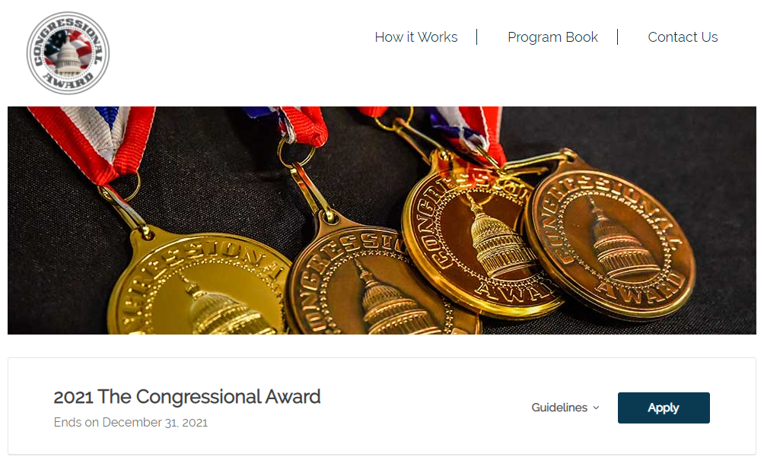
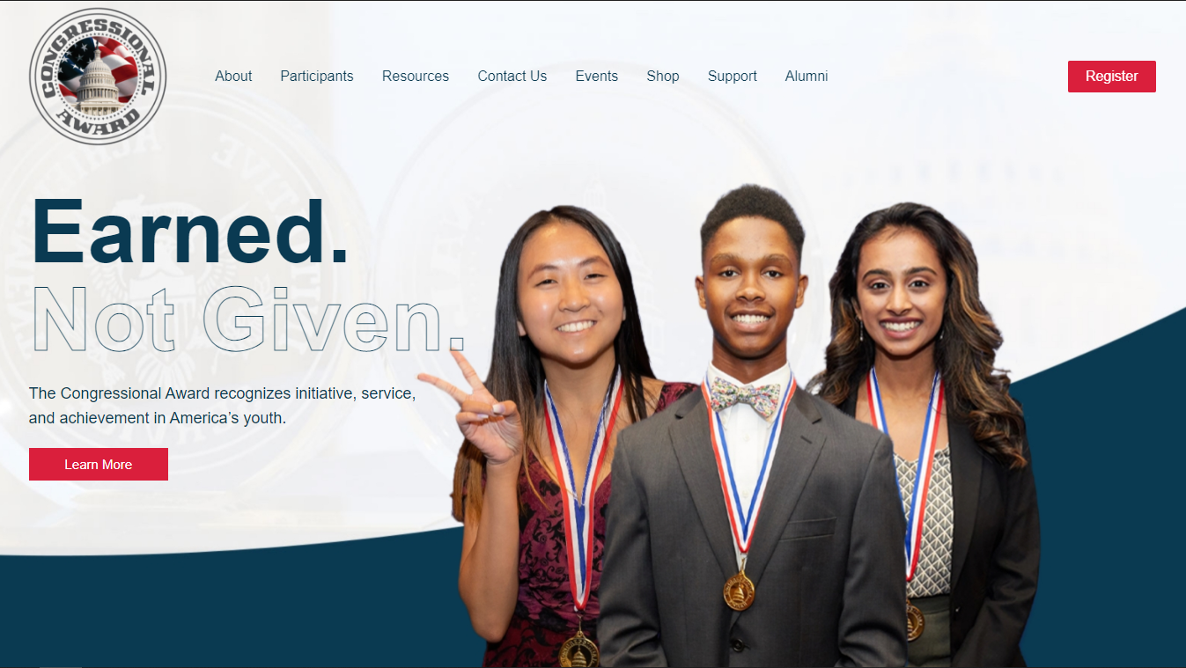
FUTURE OF THE CONGRESSIONAL AWARD
New Website
New Digital Submission Portal

Slide 30
OUR NEW WEBSITE
Simple layout and navigation
Mobile friendly
New sections like a Congressional Award Shop and Program Resources page

Slide 31
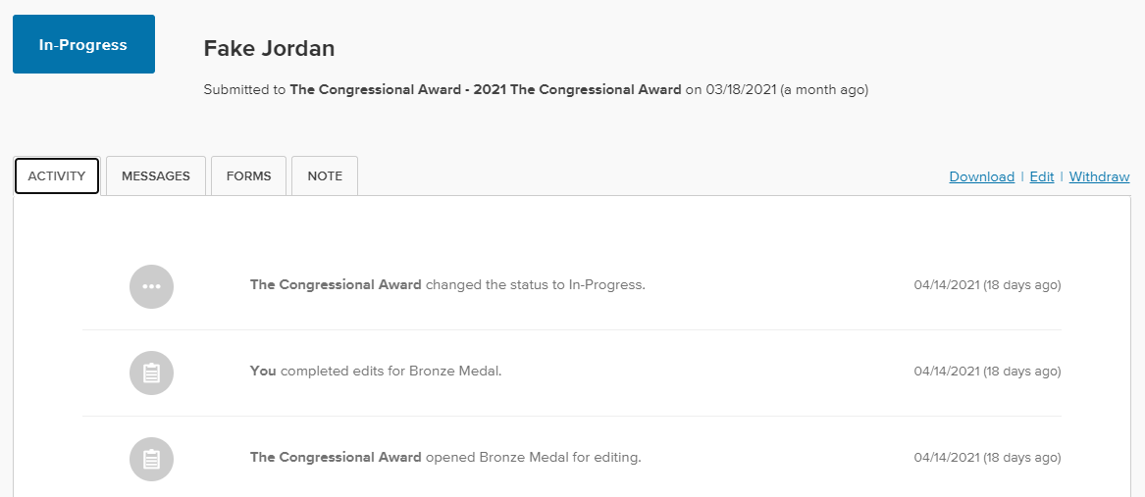
OUR NEW SUBMISSION PORTAL
Uses Submittable, an online application/submission platform
See updates/application progress as it changes
Form takes out some of the confusion and makes avoiding common mistakes much easier

Slide 32
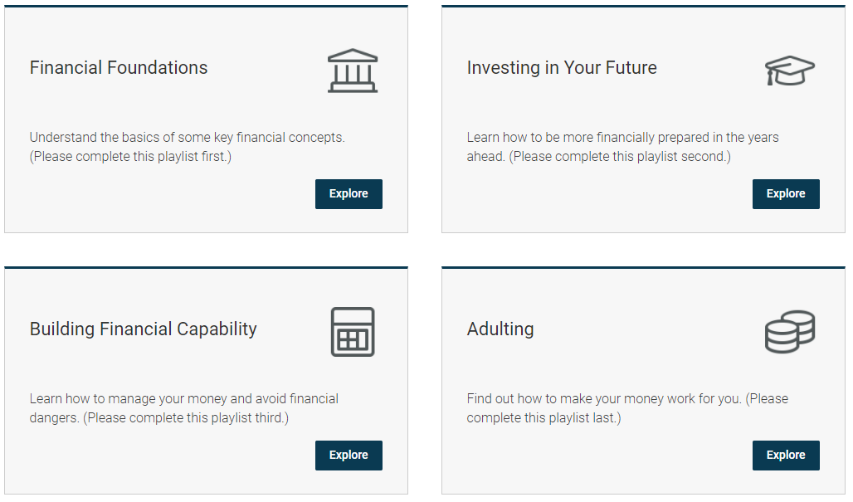
ADDITIONAL PROGRAMMING
Students working with Seniors
Charter Communications
Student Toolkit
Financial Literacy
Intuit Personal Finance Program
www.congressionalaward.org/intuit
Mental & Emotional Health
Ford Fund & Otsuka Workshops

Slide 33
Additional Resources
ADDITIONAL RESOURCES
Program Book
Record Book (Print Copy & Digital Copy)
Tools and Tips for Navigating During COVID-19
Frequently Asked Questions Website Page
Creative Activity Ideas
Contact Program Managers
Ambassadors Program

Slide 34
JOIN THE CONVERSATION
PO Box 77440
Washington, DC 20013
@The Congressional Award
@thecongressionalaward
(202) 226-0130
1-888-80-AWARD
@theaward
information@congressionalaward.org
It’s easy to join our email list!
Just text THEAWARD to 22828 to get started.
www.congressionalaward.org

Slide 35
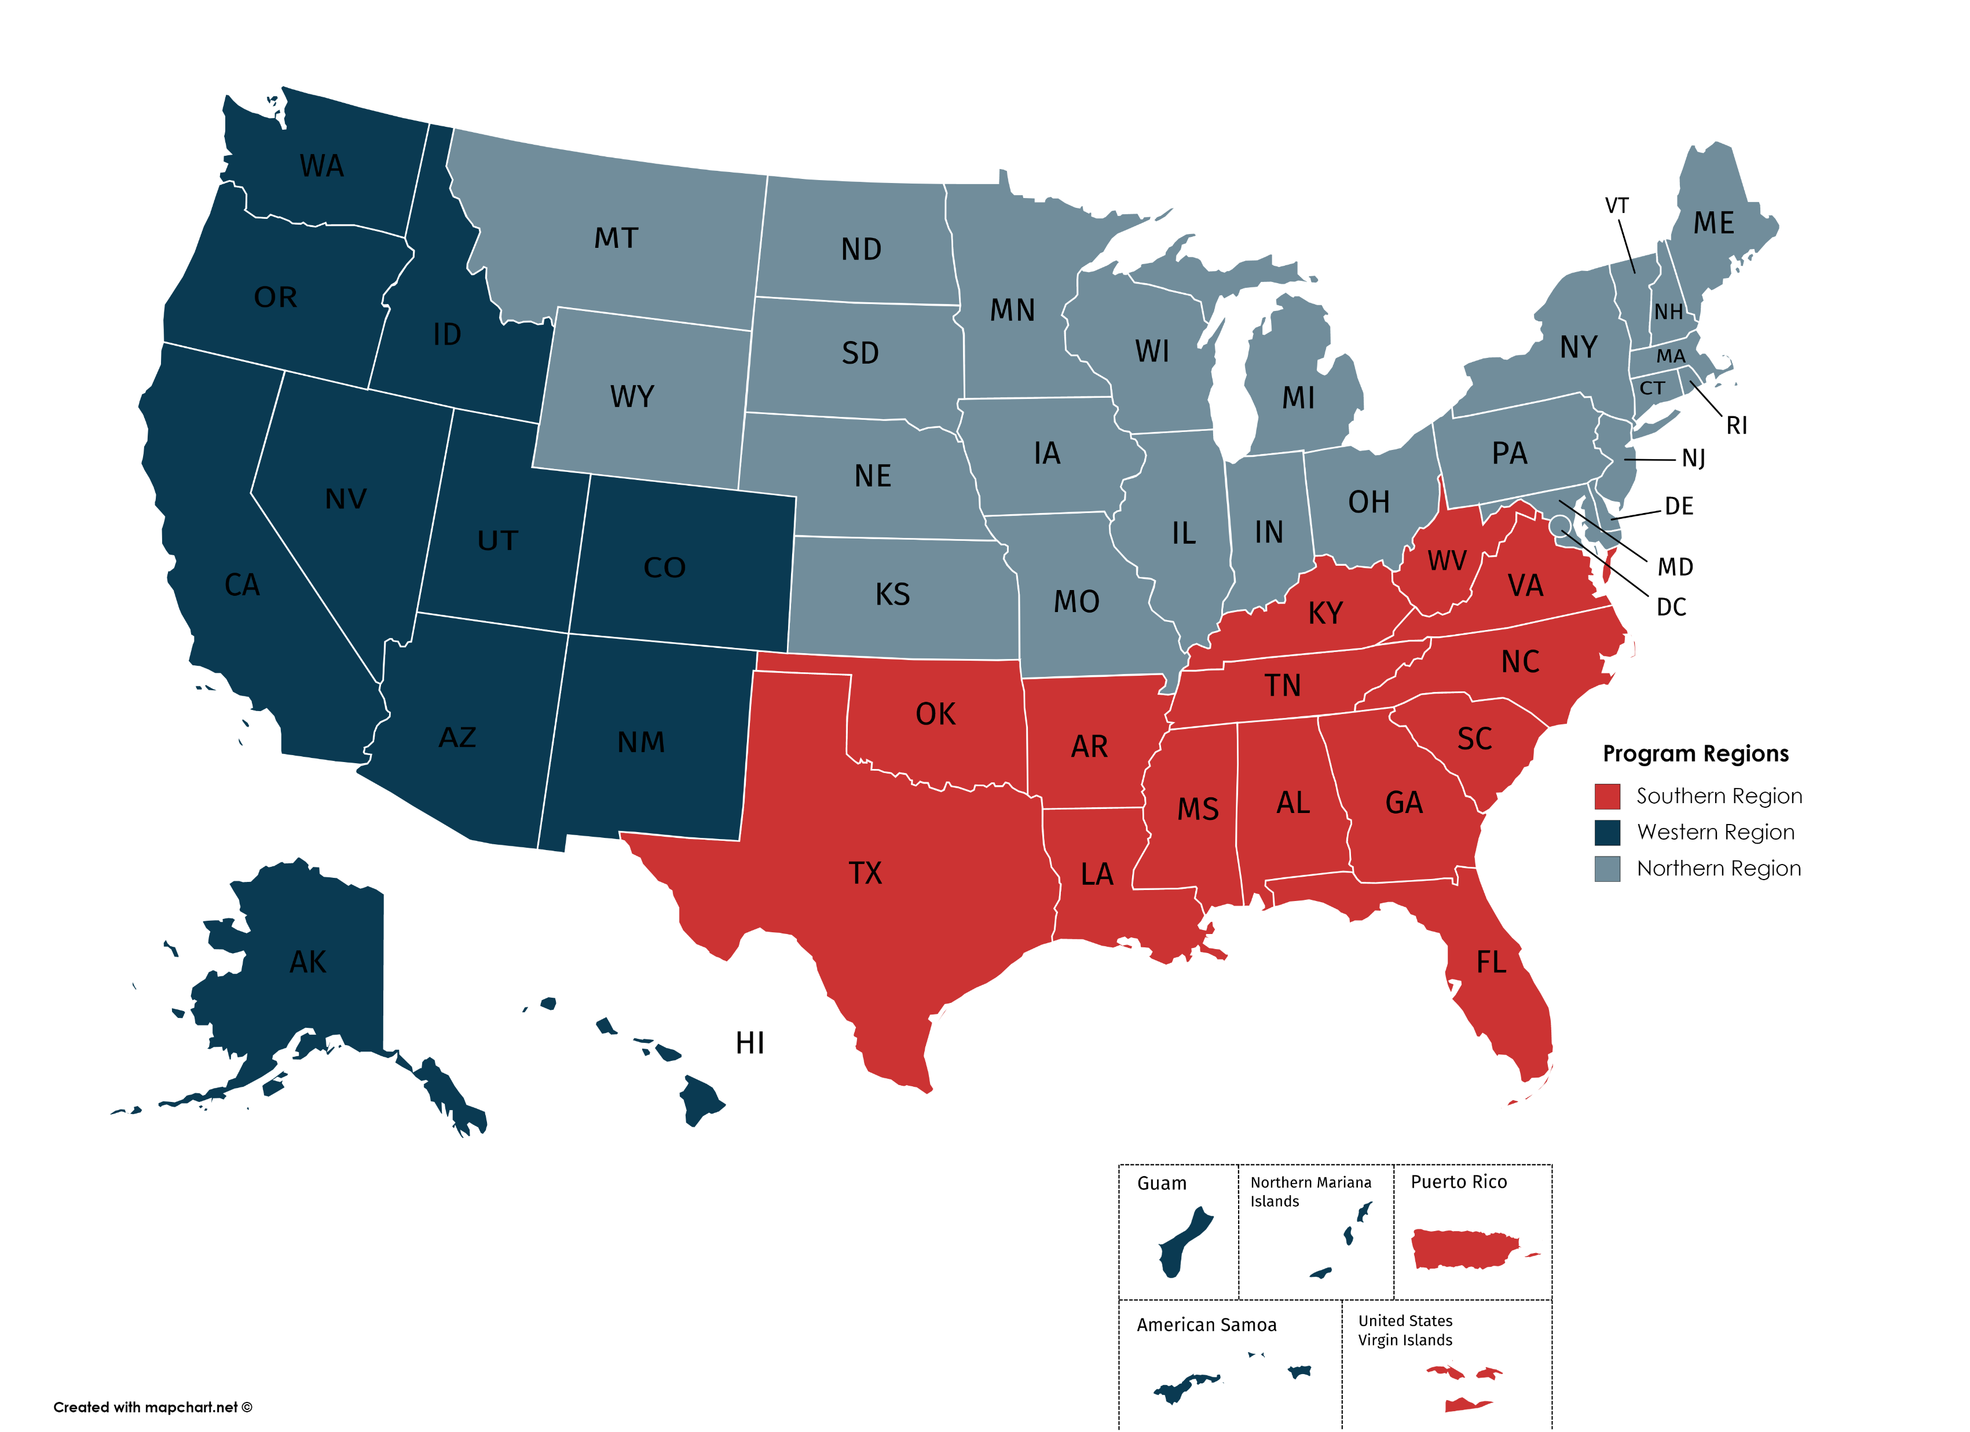
LIVE QUESTION & ANSWER
Have questions you’d like to ask via email? Find your region’s Program Manager below:
Jordan Lindsey, West Program Manager
lindsey@congressionalaward.org
Sydney Tryon, North Program Manager
tryon@congressionalaward.org
Katie McCool, South Program Manager
mccool@congressionalaward.org

