Slide 1
THE CONGRESSIONAL AWARD PARTICIPANT + ADVISOR WORKSHOP
The workshop will begin shortly. Please put any questions in the Q&A box as opposed to the chat box. We will address each question throughout the presentation and any remaining at the end.

Slide 2
ABOUT
U.S. Congress’ award for youth
Highest honor bestowed upon a youth civilian through the U.S. Senate and House of Representatives
Open to youth ages 14 – 24 *Participants can register at 13 ½
Encourages goal-setting and fosters principles of citizenship

Slide 3
ABOUT
Not an Award for Past Accomplishments
Non-partisan, voluntary, and non-competitive
No minimum GPA Average
Accommodations for young people with disabilities

Slide 4
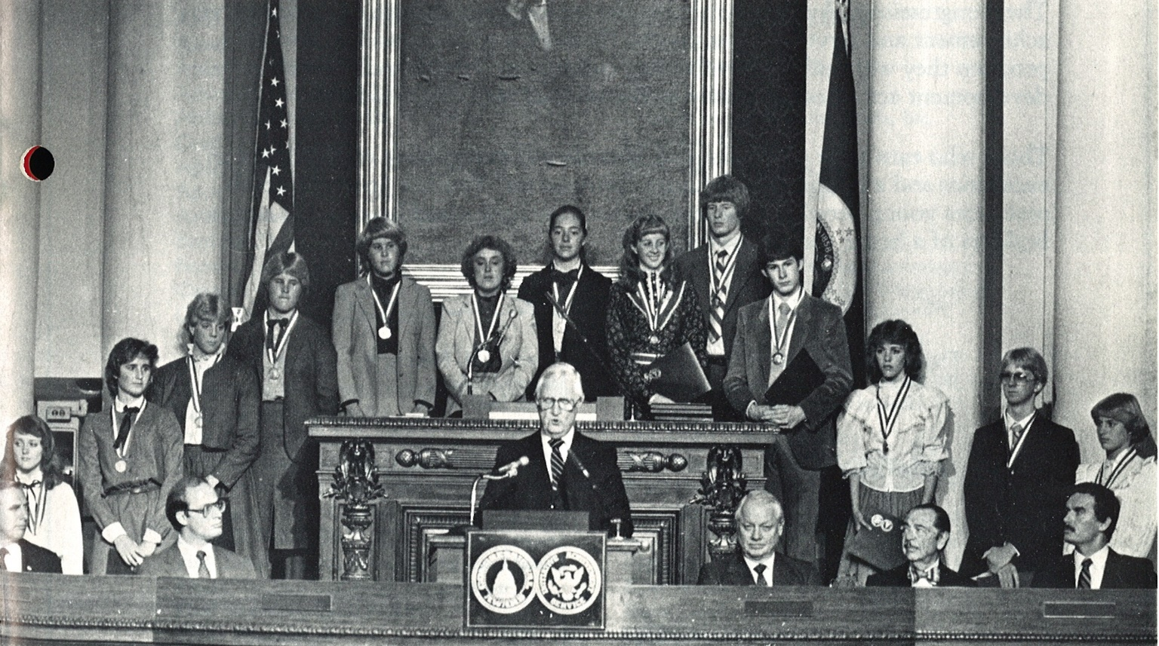
HISTORY
Founded by Congress in 1979
Public Law 96-114:
The Congressional Award Act
Public-private partnership
Non-partisan program to honor initiative, service, and achievement in America’s youth

Slide 5
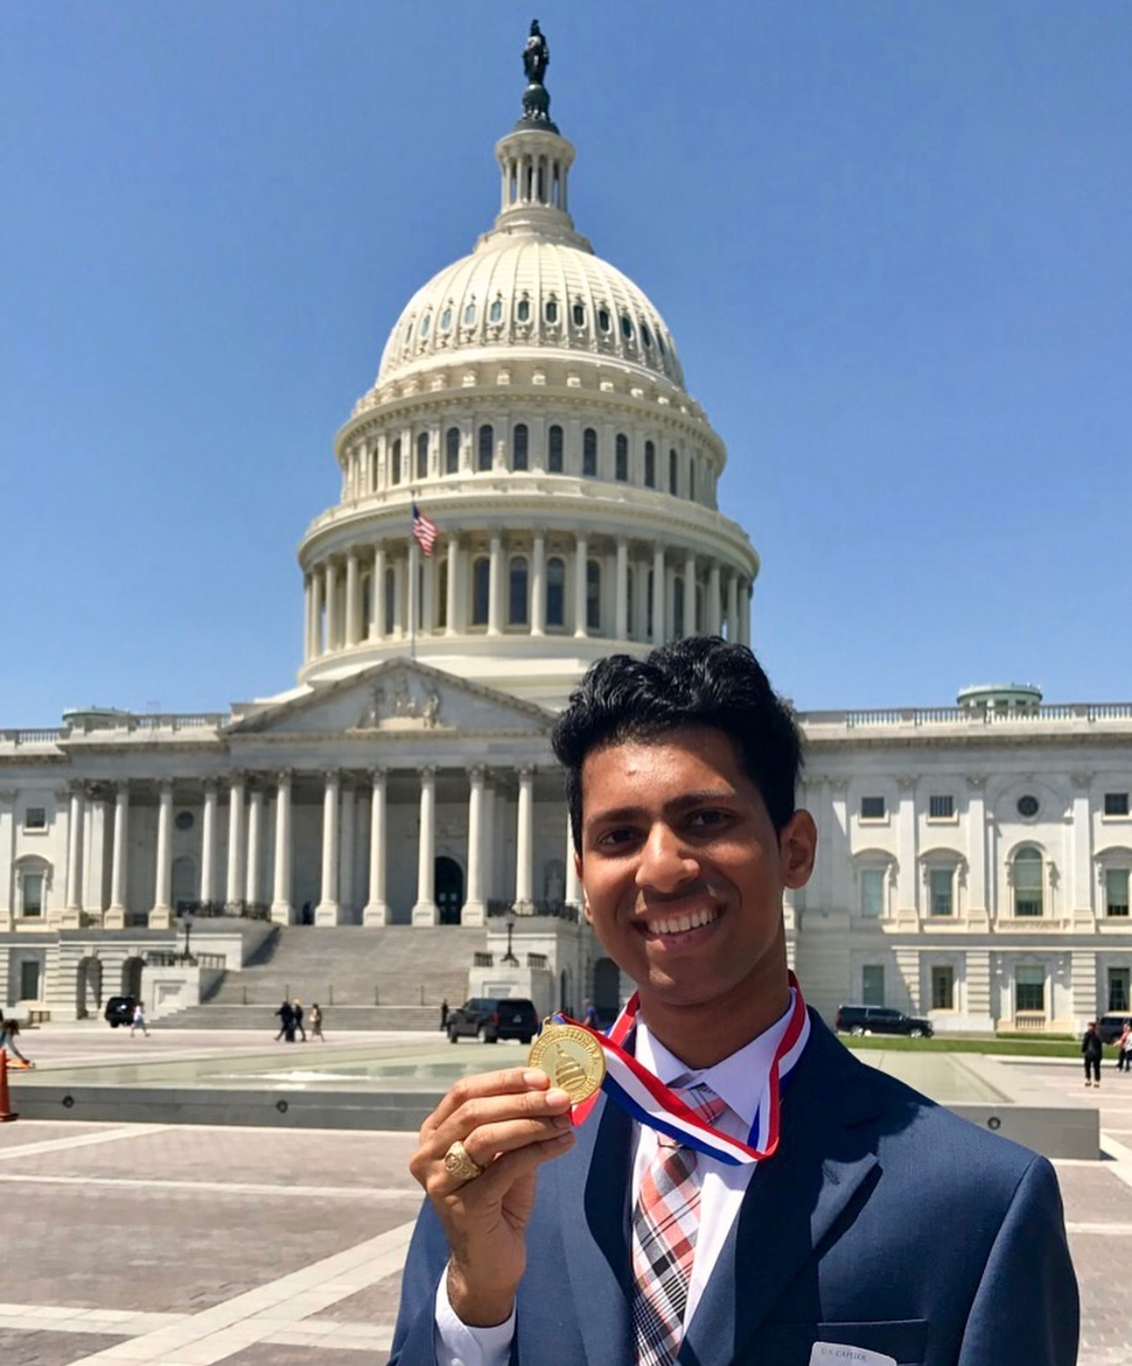
BENEFITS
Superlative for college, job,
scholarship, internship applications
Mentor-based opportunities
Serves communities near and far
Interactions with Members of Congress
Medals struck by U.S. Mint

Slide 6
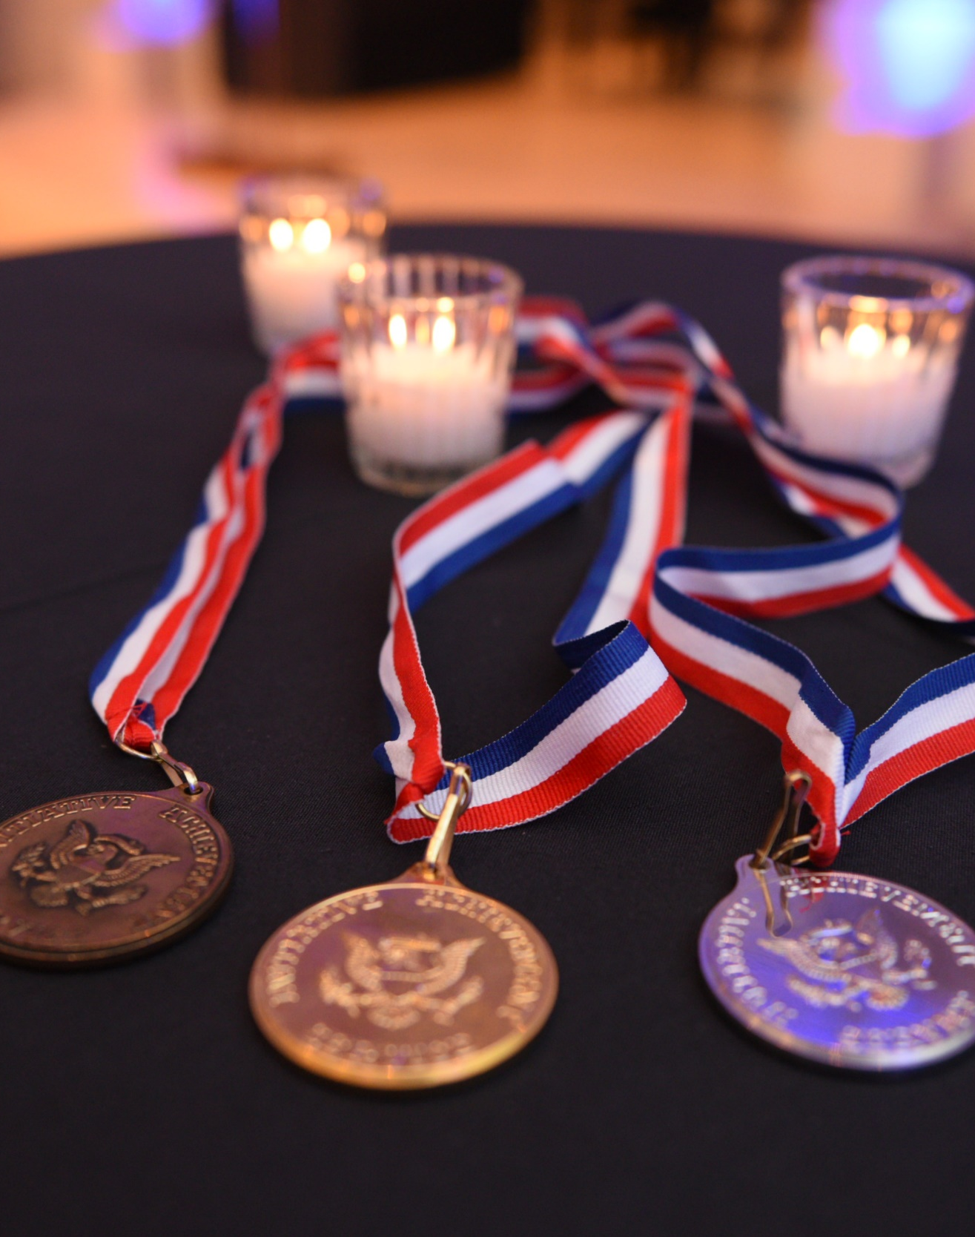
HOW TO GET STARTED
The most important step of the Program – REGISTER
Online registration on our website
$25 fee or document demonstrating financial need
Their registration is known as their activity start date
Must pick out an Advisor
Any adult that is not related to the participant who guides them through the Congressional Award journey

Slide 7
AWARD LEVELS
The program is cumulative.
Participants may start at the lowest level and progress level-by-level or advance directly to a higher level.
Bronze Certificate
Silver Certificate
Gold Certificate
Bronze Medal
Silver Medal
Gold Medal

Slide 8
PROGRAM REQUIREMENTS
Minimum hour and month totals
 | BRONZE CERTIFICATE | SILVER CERTIFICATE | GOLD CERTIFICATE | BRONZE MEDAL | SILVER MEDAL | GOLD MEDAL
VOUNTARY PUBLIC SERVICE | 30 Hours | 60 Hours | 90 Hours | 100 Hours | 200 Hours | 400 Hours
VOUNTARY PUBLIC SERVICE | No min. month requirement | No min. month requirement | 6 Months | 7 Months | 12 Months | 24 Months
PERSONAL DEVELOPMENT | 15 Hours | 30 Hours | 45 Hours | 50 Hours | 100 Hours | 200 Hours
PERSONAL DEVELOPMENT | No min. month requirement | No min. month requirement | 6 Months | 7 Months | 12 Months | 24 Months
PHYSICAL FITNESS | 15 Hours | 30 Hours | 45 Hours | 50 Hours | 100 Hours | 200 Hours
PHYSICAL FITNESS | No min. month requirement | No min. month requirement | 6 Months | 7 Months | 12 Months | 24 Months
EXPEDITION OR EXPLORATION | 1 Day | 2 Days | 3 Days | 2 Day, 1 Night Trip | 3 Day, 2 Night Trip | 5 Day, 4 Night Trip

Slide 9
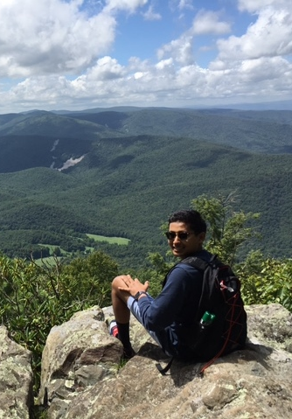
THE PROGRAM
Voluntary
Public Service
Personal Development
Physical Fitness
Expedition/Exploration

Slide 10
THE PROGRAM
General Requirements
Purpose is to set long-goals
You must complete at least 1 hour of activity for a month to count
Months do not have to be consecutive
Months in a program area only count once
No more than 8 hour of activity per day
Expedition/Exploration
Personal Development
Complete activities prior to 24th birthday
Must set goals and complete activities in all four program areas
Activity must occur after your activity start date
You can only submit one Record Book at a time
None of your activities can count for class credit

Slide 11
VOLUNTARY
PUBLIC SERVICE
Serving without compensation
Identifying a need in your community and finding a way to volunteer directly
Activities must benefit greater community at-large (public organizations, non-partisan, non-religious, no hot-button issues)
Set up to four different goals
Sharing time and talents for the benefit of others

Slide 12
VOLUNTARY PUBLIC SERVICE DO AND DON’TS
Activities coordinated or completed under the direction of a religious institution must provide service to the greater community-at-large and the activities cannot include any religious instruction or proselytizing. These activities may be counted towards Personal Development.
Activities in which you receive compensation or fulfill graduation requirements are not be allowed, this includes paid internships.
Volunteering at a private business or entity does not qualify for Voluntary Public Service. You may not volunteer to work at a private office, such as a law firm, doctor’s office, sports camps, or private dance studios as these activities do not benefit the public. However, these activities may be counted towards Personal Development.
Activities completed through an organization that charges a fee for participants may only be used towards Voluntary Public Service if the organization offers financial aid/scholarships for participants who may not be able to afford the fees.
Sharing time and talents for the benefit of others

Slide 13
VOLUNTARY PUBLIC SERVICE DO AND DON’TS
Voluntary Public Service activities must be non-partisan. You may not work for an elected official, promote a political issue or volunteer on a political campaign for Voluntary Public Service. This includes volunteering for entities with a partisan or issue-based focus. These hours can be used for Personal Development.
You may only record hours in which you are actively pursuing your goal.
Indirect service activities include planning, training, and fundraising and can only make up 25% of your total Voluntary Public Service hours. The other 75% must be direct hours, where you are interacting with and providing a direct service to the community you are serving.
Participants who are establishing their own non-profit organization should contact the National Office to discuss their goals and activities and special consideration for the number of indirect hours that they complete.
Sharing time and talents for the benefit of others

Slide 14
PERSONAL DEVELOPMENT
Pursue a new activity or
advance ability an existing interest
Goals must be specific and measurable
Count part-time work if you’re a full-time student. Count educational activities if you’re employed full-time.
Set up to two different goals
Developing skills in a personal,
career, or social interest

Slide 15
PERSONAL DEVELOPMENT DO AND DON'TS
If you are a full-time student, taking on a part-time job may be counted towards Personal Development.
You may not count any activities that you receive class credit for. Improving your skills in a subject or studying for a standardized test may be used for Personal Development if your activities occur outside of school and are not a requirement or assignment for any class.

Slide 16
PHYSICAL
FITNESS
Goals cannot be competitive
Goals must be specific and measurable
Include current fitness level and determine where you’d like to advance
Fitness activities do not have to be strenuous in order to be challenging
Set up to two different goals
Improving one’s quality of life

Slide 17
PHYSICAL FITNESS DO AND DON’TS
School sports and team practices are acceptable activities if they are completed outside of class time. Gym class or PE does not count for Physical Fitness.
Goals should be personally challenging and focused on your individual well-being. A goal of becoming team captain is not an acceptable goal as your success depends on the decisions of others.
Using activity trackers, such as Fitbits, may be useful in tracking your activities. However, activities that are part of your daily routine (i.e., walking to class) cannot be counted towards your Physical Fitness goal. Your activities need to take place outside of your daily routine.
Improving one’s quality of life

Slide 18
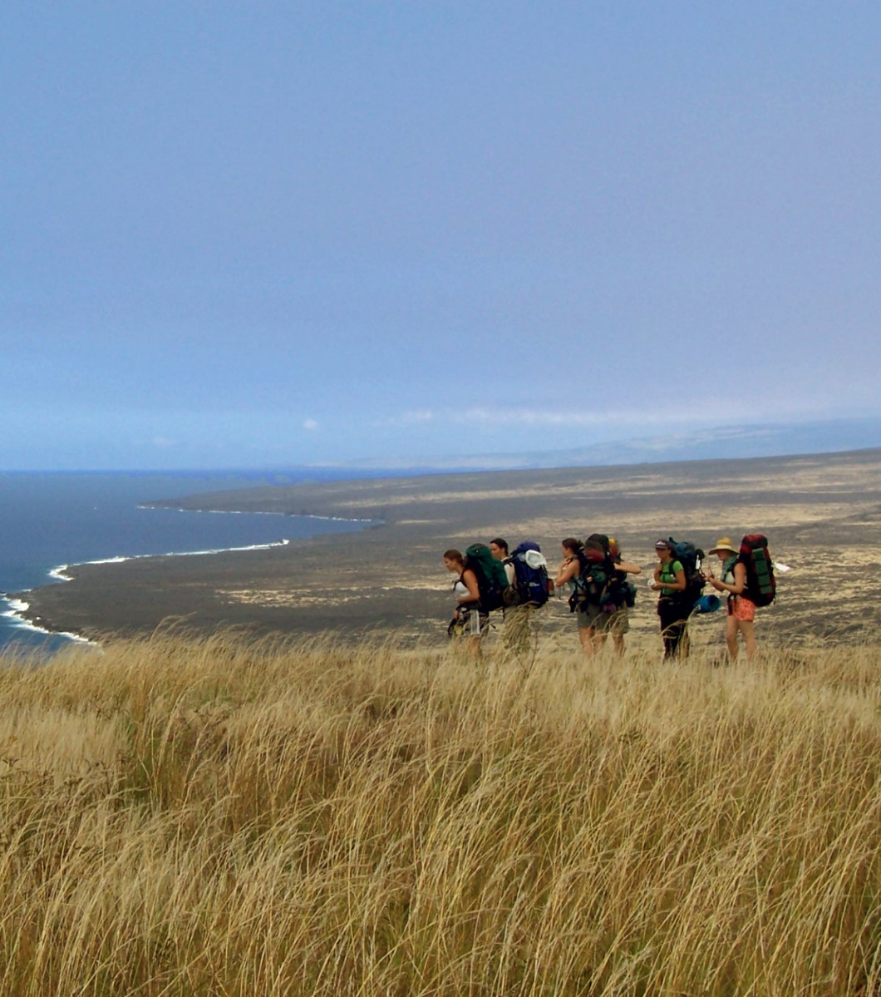
EXPEDITION or
EXPLORATION
Expedition: Discover the great outdoors
Exploration: Experience culture, history, humanity
Develop a spirit of adventure
Organize, prepare, and execute
Does not have to be costly or far off
Immersion in an unfamiliar
environment or culture

Slide 19
EXPEDITION OR EXPLORATION DO AND DON'TS
An Expedition/Exploration should be a new, unique experience. It should require a level of challenge that enables you to step outside of your daily routine, leave your comfort zone, and immerse yourself in a new culture or environment.
You must complete 6-8 hours of immersive activities per day for that day to count towards the day requirement.
Must be a trip that you plan and lead. Mission trips, conferences, cruises, competitions, workshops, and sign-up and go trips may not be used for the Expedition/Exploration.
Your Expedition/Exploration should not consist of activities to pursue your next stage in life. This includes visiting/touring prospective colleges or participating in an internship or work-study program.
Immersion in an unfamiliar
environment or culture

Slide 20
EXPEDITION OR EXPLORATION DO'S AND DON'TS
If you choose to complete a trip that meets the overnight and/or day requirements for a higher level of the award than what you are applying for, you may submit it with a lower-level Record Book. If you would like to re-submit your Expedition/Exploration with a higher-level Record Book you may do so, keeping in mind that the National Office will not necessarily approve a trip at a higher level, even if it was approved for a lower level.
Medal levels of the Award require that the days and nights be consecutive. You cannot combine trips to meet the requirements of the Bronze, Silver or Gold Medal.
You only need to submit one Expedition/Exploration with each Record Book submission. For example, if your first Record Book submission is for the Silver Medal, you only need to submit a two consecutive overnight trip. You do not need to submit a one-day trip for the Bronze Certificate, a two-day trip for the Silver Certificate, etc.
Please ensure that you submit a thorough write-up of your trip. The Record Book includes a list of questions to help guide you in your write-up. Your submission should not consist of brief bullet points.
Immersion in an unfamiliar
environment or culture

Slide 21
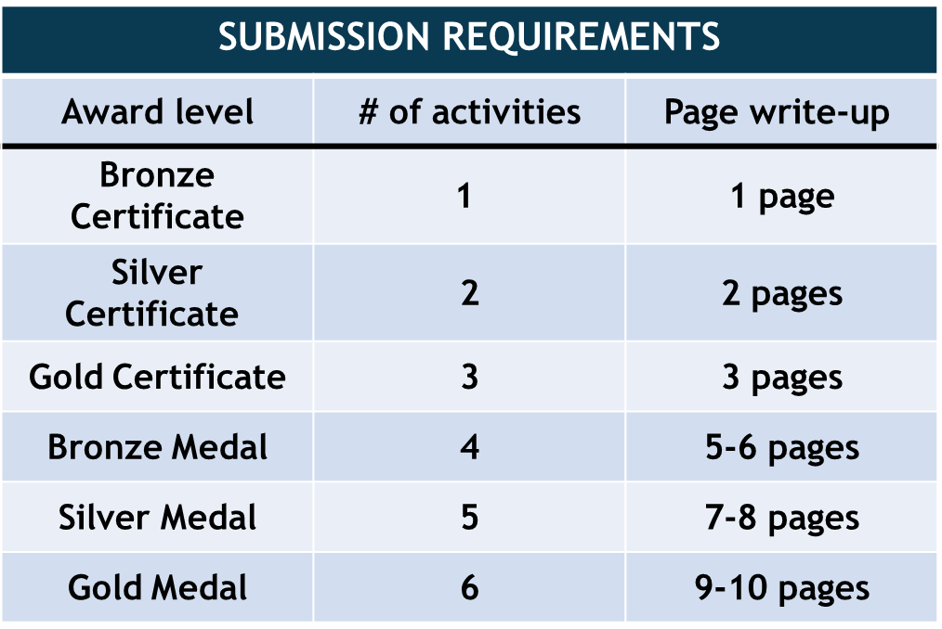
VIRTUAL EXPEDITION/EXPLORATIONS
Accommodation extended FOR GOOD
All participants will be able to submit Virtual Expeditions/Explorations with modified guidelines
Participants will choose a country or location and pick activities to explore the history, culture, and customs.
Taste of the world, interview a local, landmark review, virtual museum tour, etc.
NEW! New activities will be added next year
Participants must complete both their virtual activity questions and the write-up questions.
Immersion in an unfamiliar
environment or culture

Slide 22
DEADLINES & CRITERIA
GOLD MEDALIST DEADLINE | GOLD REVISION DEADLINES
FEBRUARY 1ST, ANNUALLY | MARCH 15TH, ANNUALLY

Slide 23
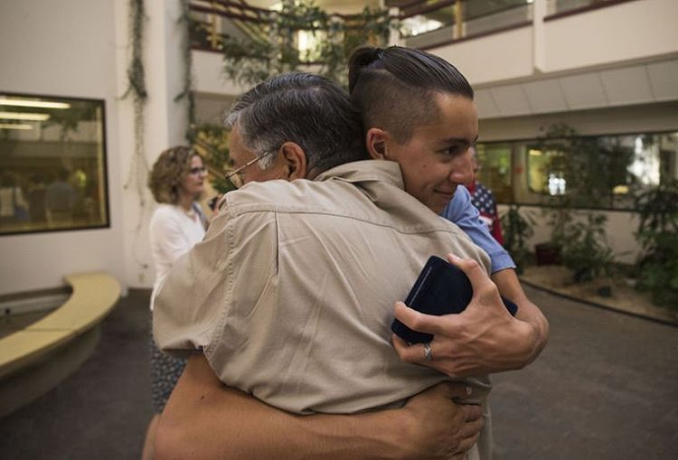
ADVISOR & VALIDATOR GUIDE
As an Advisor or Validator, you play an important role!
Advisors guide participants through the goal-setting process in each of the four program areas and monitor their progress toward the Congressional Award.
Validators assist the participant with individual activities.
Check out full advisor/validator guide here!

Slide 24
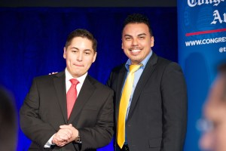
Check out full advisor/validator guide here!
YOUR ROLE AS THE ADVISOR:
Review the Congressional Award requirements and guidelines as provided in the program booklet
Assist the participant in setting goals
Identify appropriate activities and qualified Validators
Maintain periodic contact with the participant
Help the participant revise and set new goals and find activities to achieve them
Encourage the participant to obtain digital signatures from their validators
Once the participant has completed their Submittable Record Book, review their records and help check the complete the online Record Book. Please be sure to provide comments.
Make certain that the participant pushes ‘save’ on the online Record Book
Once the participant has submitted their online Record Book, work with them to set new goals and begin working on the next level of the Award!

Slide 25
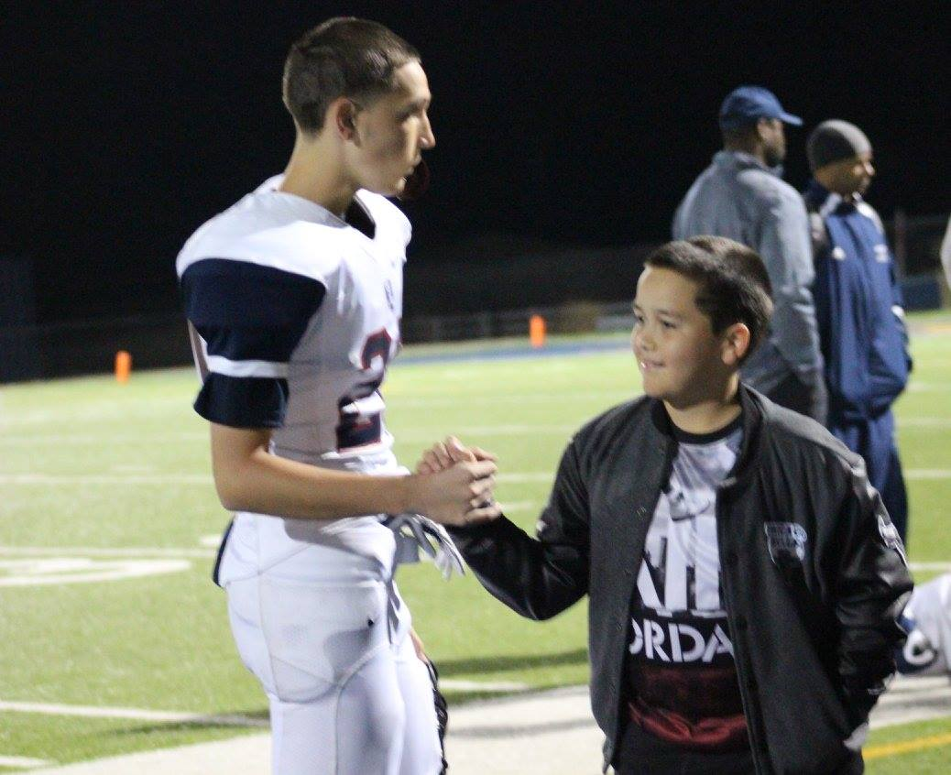
THE ROLE OF THE VALIDATOR:
Review the Congressional Award requirements and guidelines
Discuss the specific requirements for the program area in which you’ll be working with the participant
Help the participant identify their starting level
Make certain that the participant’s goal is personally challenging, achievable, worthwhile, measurable, and fulfilling
Review all of the appropriate documentation and digitally sign their online Record Book via a Submittable notification email.
Check out full advisor/validator guide here!

Slide 26
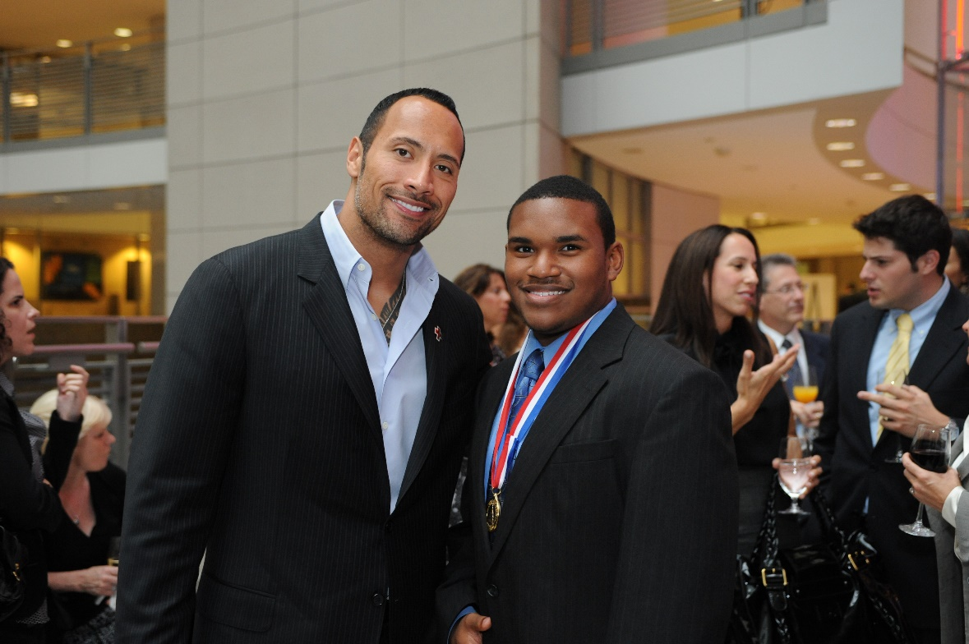
WHO IS ELIGIBLE?
Other than parents, relatives, and peers, any adult may serve as an Advisor or Validator.
Ex. Teachers, coaches, neighbors, club sponsors, and civic leaders
Congressional Award Gold Medal earners, regardless of their age.
It is the responsibility of the participants to identify their Advisor and Validators.
The appropriate Validator depends on the participant’s activities.
Validators should be knowledgeable in the activities a participant pursues to achieve a particular goal.
Ex. A young person’s goal and activities involved basketball; a coach would make a suitable validator.
Ex. A young person volunteered at an animal shelter, an employee or the volunteer coordinator would be appropriate
Yes, even Dwayne ‘The Rock’ Johnson is eligible!
If there is confusion or difficulties around locating or getting Validator signatures, participants can reach out to their regions Program Manager for assistance!

Slide 27
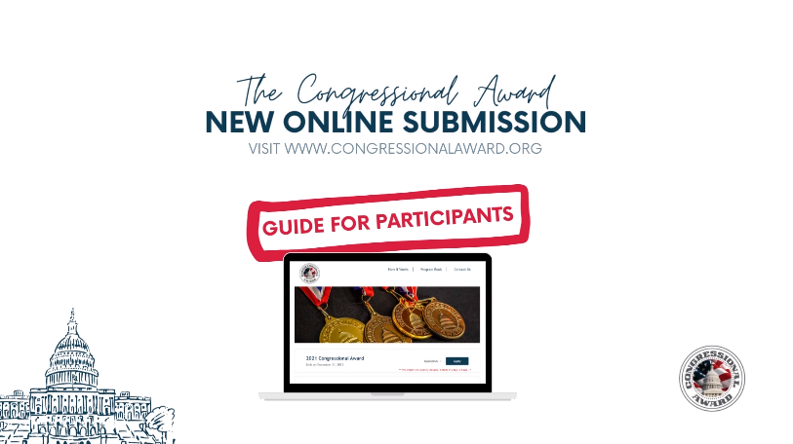
Online Record Book - Submittable
Submit records books online with Submittable
Visit the ‘Current’ participants page on the Congressional Award website to get started.
Accommodations are available for participants experiencing a lack of digital resources.
Learn how to transfer,
it’s easy!
Preview the Submittable form
with helpful instructions!
Transfer from Paper to Submittable
VIDEO: How to Guide for Submittable
Submittable
Tips & Errors
PDF: How to Guide for Submittable

Slide 28
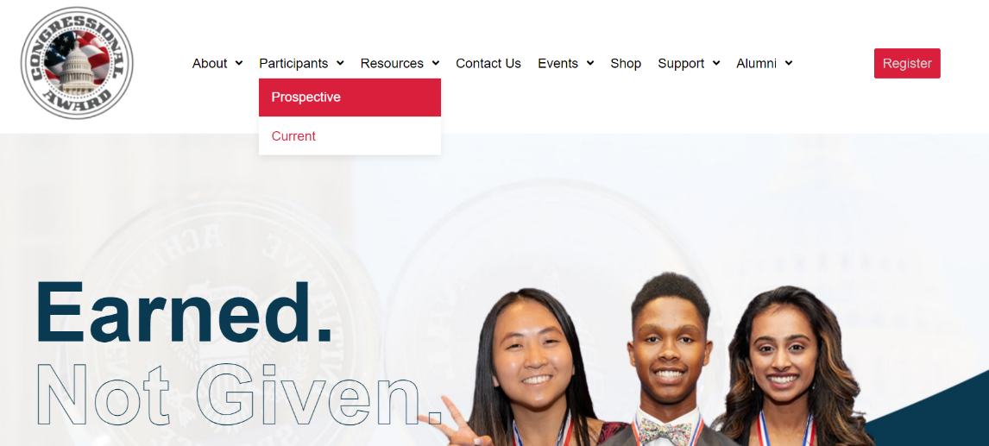
Online Record Book - Submittable
Get Started with Submittable!
On the Congressional Award website, go to the “Current” Participants tab.
Scroll to “Ready to Start your Record Book?” Click here.
1. Go to ‘Current’ tab
2. Click here

Slide 29
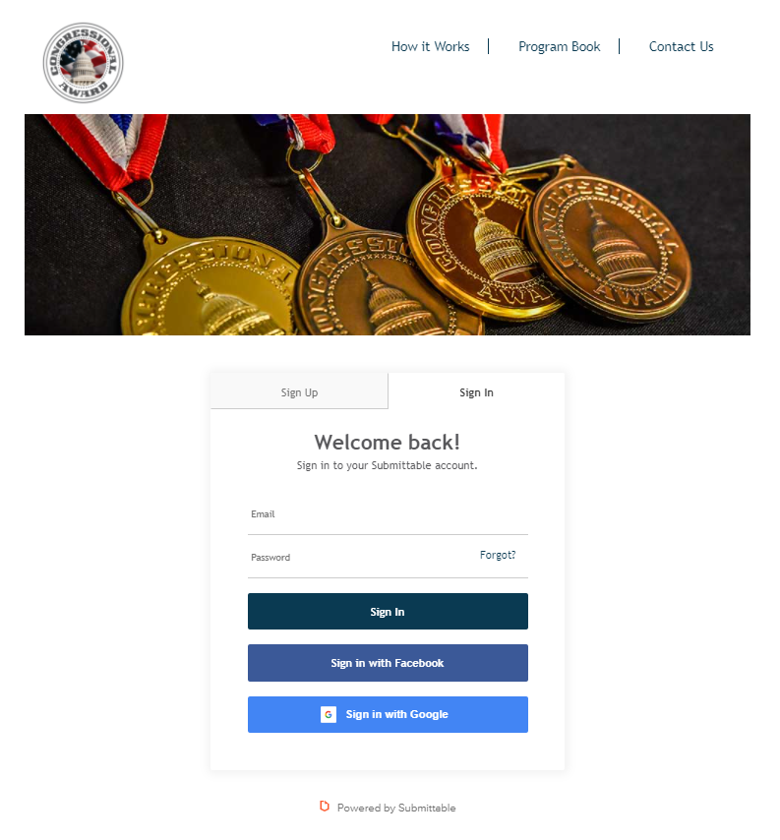
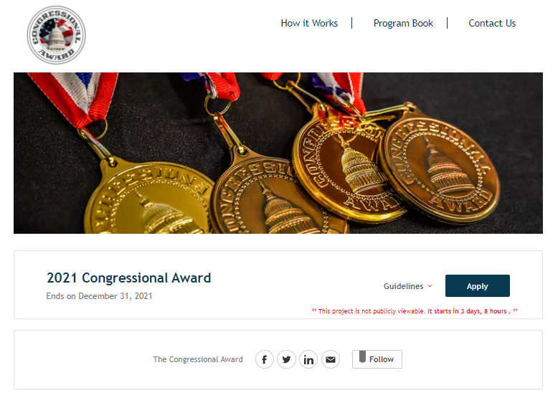
Online Record Book - Submittable
3. ‘Sign Up’
and make a new account
(Participants Only)
Note: participants were not given a login and they must make their own.
2. Click Apply
Note: Participants do not need to enter previously earned or submitted awards. Only new submissions.

Slide 30
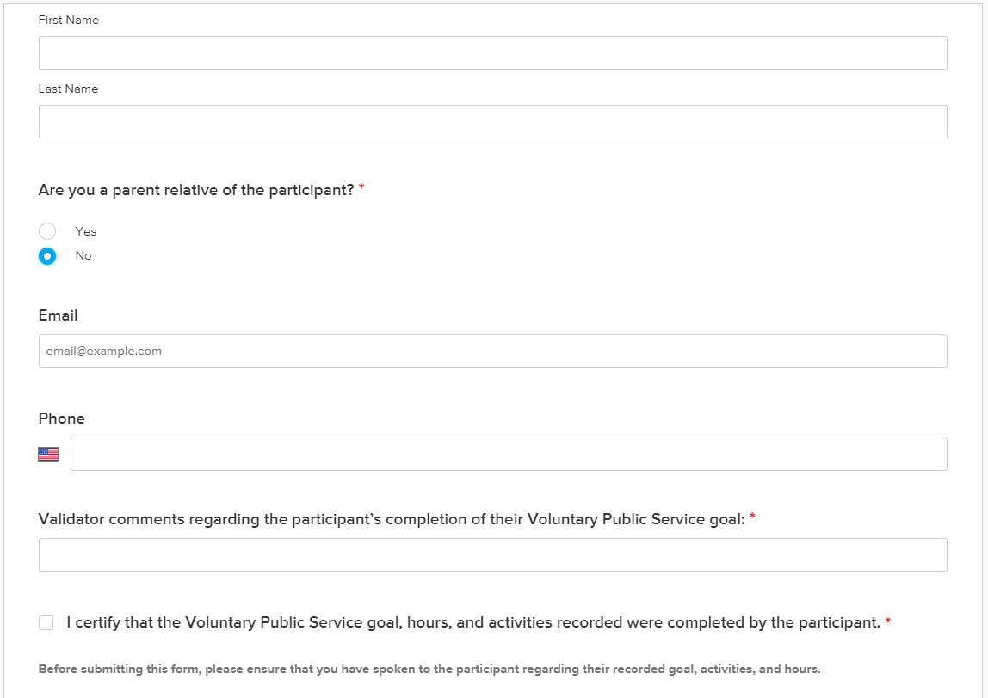
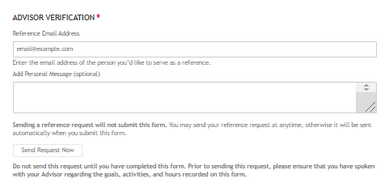
Online Record Book - Submittable
Participants must obtain digital Advisor and Validator signatures.
If you have multiple activities under a goal, select 1 validator to validator for the entire goal.
Note: Participants enter their information and click ‘send request now.’
Advisor and Validators are sent an email notification to validate.
Participant View
Advisor View
‘Send Request Now’

Slide 31
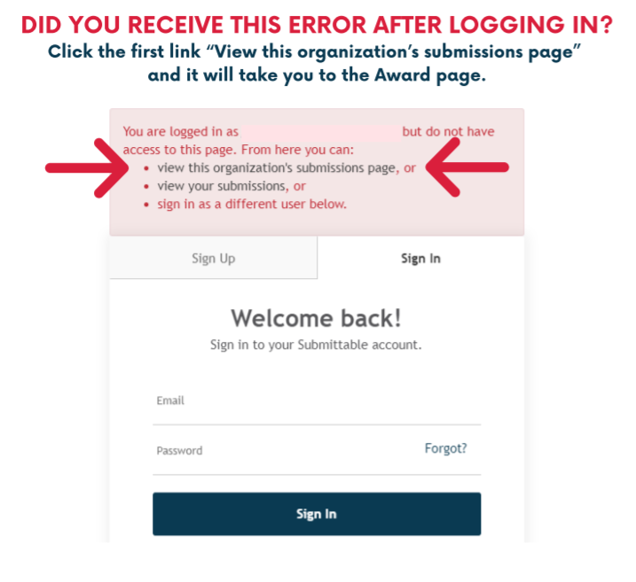
Common Login Error

Slide 32
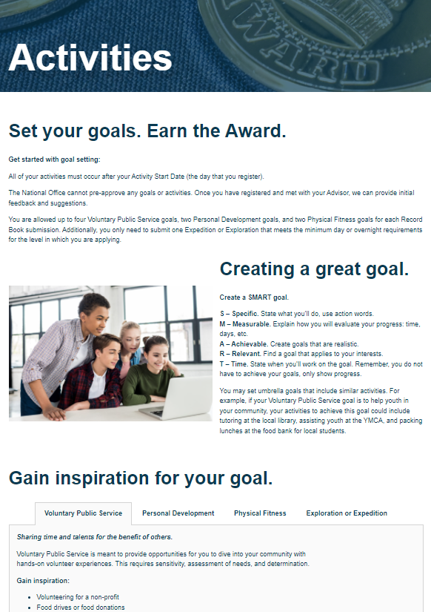
Additional Resources
ACTIVITIES PAGE
Ideas for Activities
Check if your activities are allowed
Learn how to create a smart goal
This is located on the ‘The Program’ tab.

Slide 33
Additional Resources
THE CAF WORKBOOK
The perfect tool to help you get started with the Congressional Award!
Located under “Current Participants” section
Workbook + Hour Log Sheet
Activity descriptions, checklists, example goals, guidelines, and more!
What it is – An optional tool that can keep track of your activity before you submit online on Submittable
What it is not – A Record Book

Slide 34
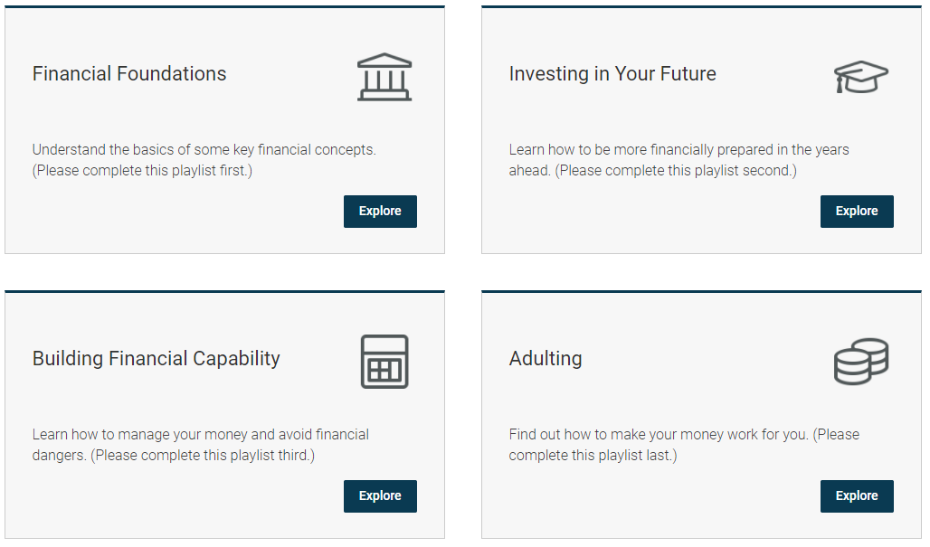
ADDITIONAL PROGRAMMING
Students working with Seniors
Charter Communications
Student Toolkit
Financial Literacy
Intuit Personal Finance Program
Mental & Emotional Health
Ford Fund & Otsuka Workshops
See all of our ongoing initiatives here!

Slide 35
Additional Resources
ADDITIONAL RESOURCES
Program Book
Frequently Asked Questions Website Page
Program Managers
Ambassadors

Slide 36
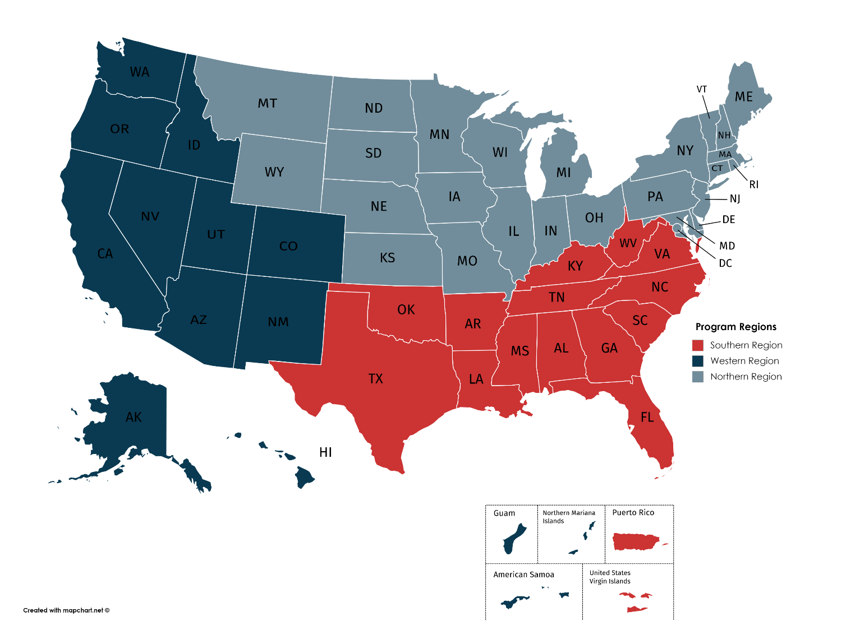
LIVE QUESTION & ANSWER
Have questions you’d like to ask via email? Find your region’s Program Manager below:
Francesca D’Ambrosi, West Program Manager
dambrosi@congressionalaward.org
Lukas Meyer, North Program Manager
meyer@congressionalaward.org
Eric Fernandez, South Program Manager
fernandez@congressionalaward.org
Notes:
Guam, Northern MI, American Samoa – West Region
Military Bases, Puerto Rico, US Virgin Islands – South Region

Slide 37
JOIN THE CONVERSATION
PO Box 77440
Washington, DC 20013
@The Congressional Award
@thecongressionalaward
(202) 226-0130
1-888-80-AWARD
@theaward
information@congressionalaward.org
www.congressionalaward.org

